Slide 1
Random Forests
Predicting Laboratory Earthquakes from Acoustic Emissions
Dr Thomas Berndt

Slide 2
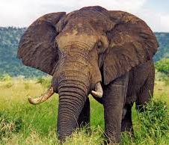










Decision Trees
Is it an animal or a fruit?
Features: Weight, shape, color, fur.

Slide 3
Decision Trees
Does it have a fur?
Yes
No

Slide 4
Decision Trees
Does it have a fur?
Does it have a bright color?
Yes
No
Yes
No

Slide 5
Decision Trees
Does it have a fur?
Does it have a bright color?
Is it round?
Yes
No
Yes
No
Yes
No

Slide 6

Decision Trees
Test set
Does it have a fur?
Does it have a bright color?
Is it round?
Yes
No
Yes
No
Yes
No
Is it heavier than 1 kg?
Yes
No

Slide 7
Decision Trees
Is it round?
Yes
No

Slide 8
Decision Trees
Is it round?
Does it have a bright color?
Yes
No
Yes
No

Slide 9
Decision Trees
Is it round?
Does it have a bright color?
Yes
No
Yes
No
Is it heavier than 20 g?
Yes
No

Slide 10

Decision Trees
Test set
Is it round?
Does it have a bright color?
Yes
No
Is it heavier than 1 kg?
Yes
No
Yes
No
Is it heavier than 20 g?
Yes
No

Slide 11
Decision Trees
Does it have a bright color?
Yes
No

Slide 12
Decision Trees
Does it have a bright color?
Is it heavier than 1 kg?
Yes
No
Yes
No

Slide 13
Decision Trees
Does it have a bright color?
Is it heavier than 1 kg?
Yes
No
Is it heavier than 20 g?
Yes
No
Yes
No

Slide 14

Decision Trees
Test set
Does it have a bright color?
Is it heavier than 1 kg?
Yes
No
Is it heavier than 20 g?
Yes
No
Yes
No
Is it round?
Yes
No

Slide 15
Random Forest
Animal
(2/3)
Animal
(2/3)
Fruit
(3/3)
Test set
Bright color?
Fur?
Round?
Yes
No
Yes
No
Yes
No
Bright color?
Bright color?
Round?
>1 kg?
>1 kg?
> 20 g?
Yes
No
Yes
No
Yes
No
Yes
No
Yes
No
Yes
No
>1 kg?
>20 g?
Round?
Fruit
Fruit
Fruit
Fruit
Fruit
Fruit
Animal
Animal
Animal
Yes
No
Yes
No
No
Yes
Animal
Fruit
Animal
Fruit
Fruit
Animal

Slide 16
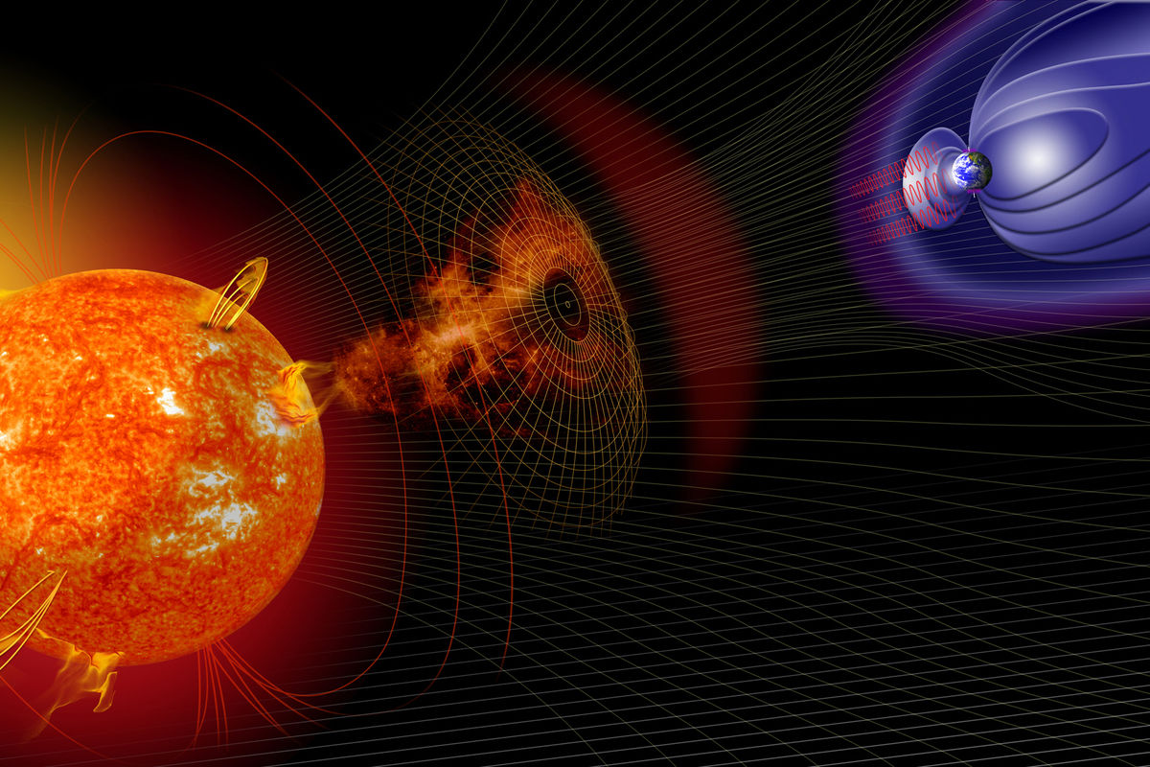


Geomagnetic Storms
https://www.drivendata.org/competitions/73/noaa-magnetic-forecasting/

Slide 17
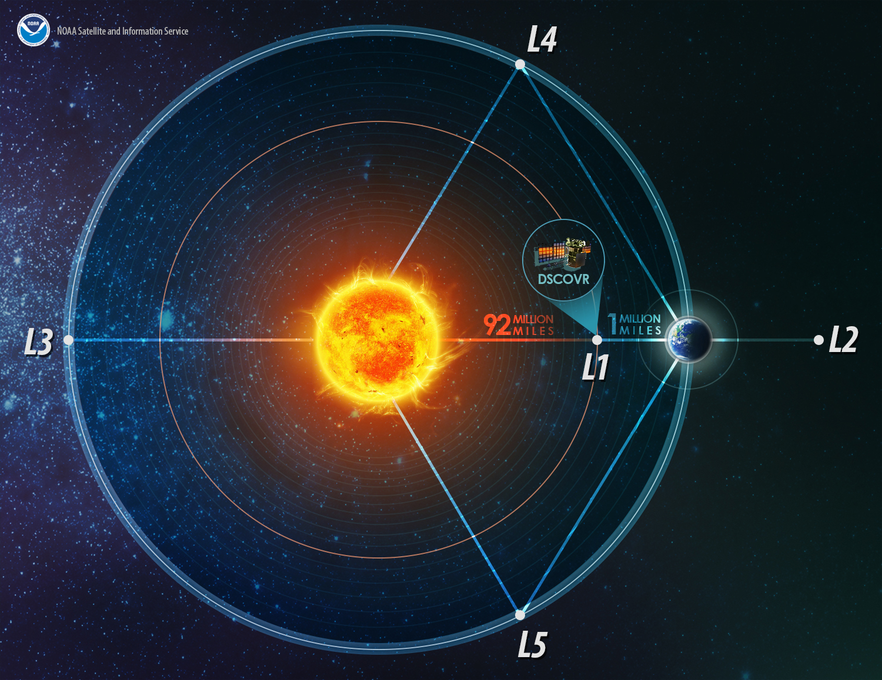
Satellites: NOAA DSCOVR & NASA ACE
Lagrange points:
Sun's gravity
Earth's gravity
Centrifugal force
cancel out.
→ stationary

Slide 18
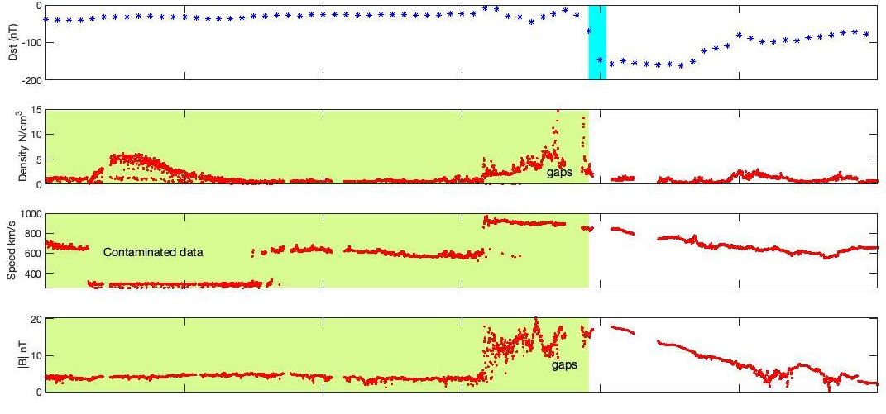
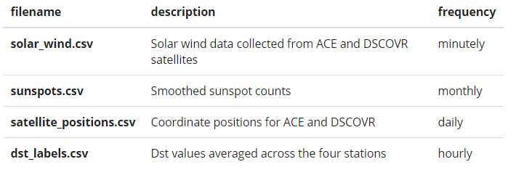
MagNet: Model the Geomagnetic Field
Forecast DST (Disturbance Storm-Time Index) (next 1 hour)

Slide 19
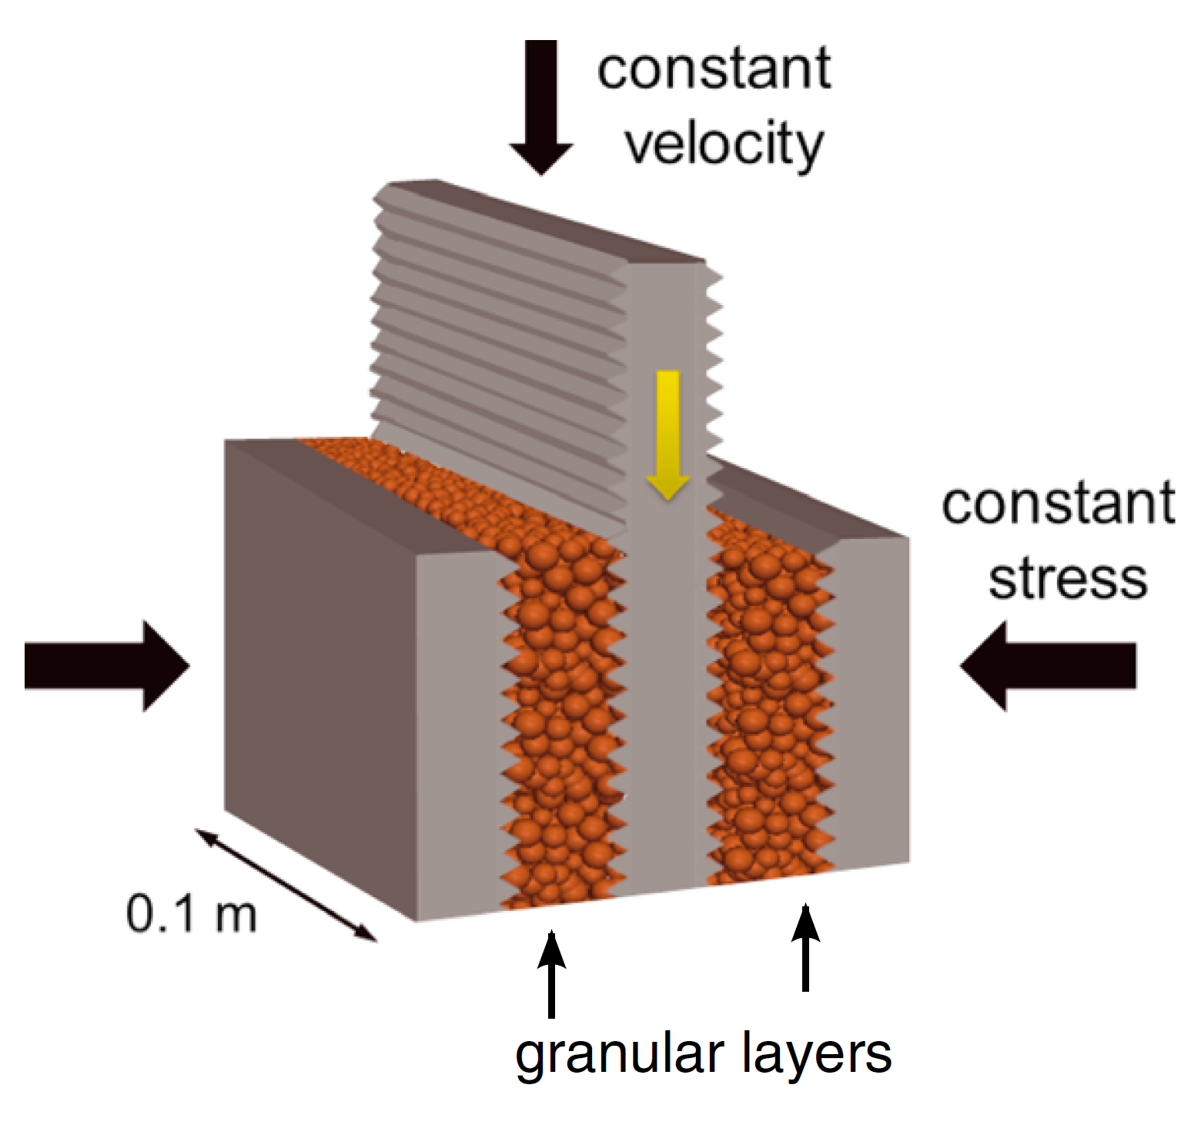
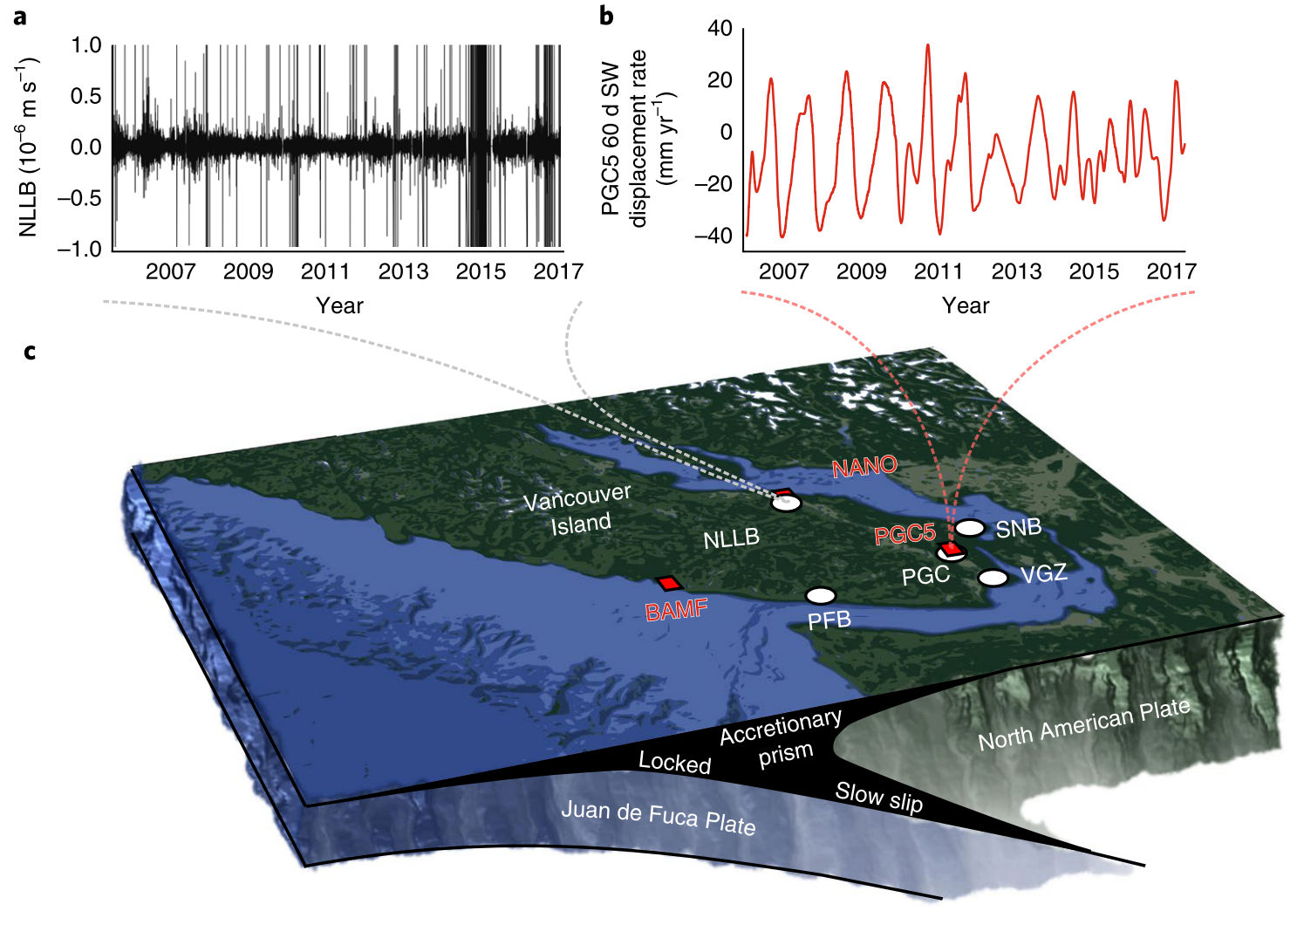
Machine Learning Predicts Laboratory Earthquakes
Acoustic emission
Seismic emission
Johnson, P. A., Ferdowsi, B., Kaproth, B. M., Scuderi, M., Griffa, M., Carmeliet, J., Guyer, R. A., Bas, P. Y. Le, Trugman, D. T., & Marone, C. 2013. “Acoustic Emission and Microslip Precursors to Stick-Slip Failure in Sheared Granular Material.” Geophysical Research Letters 40 (21): 5627–31. https://doi.org/10.1002/2013GL057848.
Rouet-Leduc, B., Hulbert, C., & Johnson, P. A. 2019. “Continuous Chatter of the Cascadia Subduction Zone Revealed by Machine Learning.” Nature Geoscience 12 (1): 75–79. https://doi.org/10.1038/s41561-018-0274-6.

Slide 20
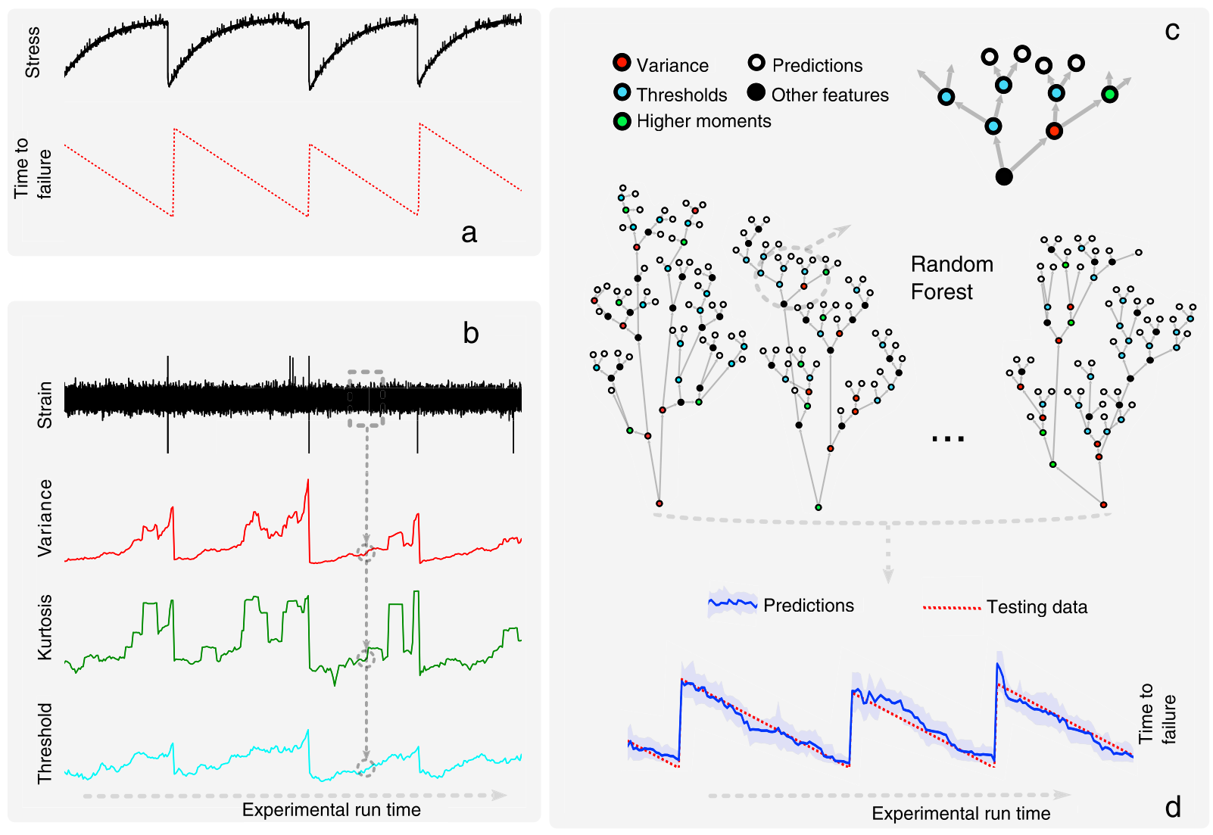
Machine Learning Predicts Laboratory Earthquakes
Rouet-Leduc, B., Hulbert, C., Lubbers, N., Barros, K., Humphreys, C. J., & Johnson, P. A. 2017. “Machine Learning Predicts Laboratory Earthquakes.” Geophysical Research Letters 44 (18): 9276–82. https://doi.org/10.1002/2017GL074677.

Slide 21
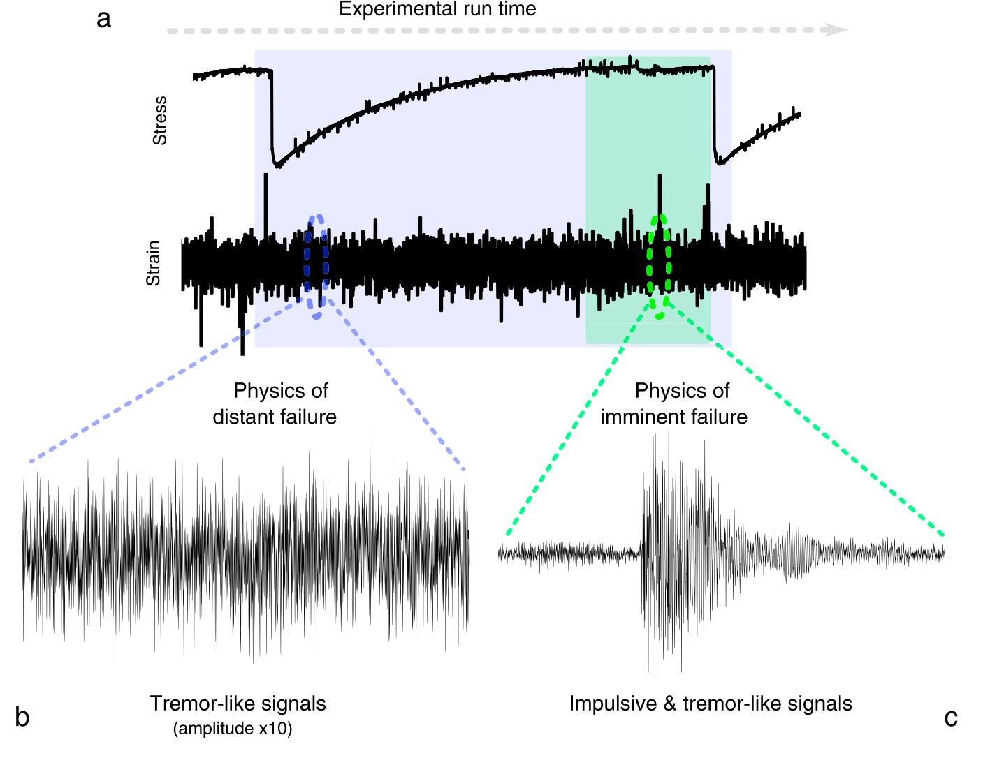
Machine Learning Predicts Laboratory Earthquakes
Rouet-Leduc, B., Hulbert, C., Lubbers, N., Barros, K., Humphreys, C. J., & Johnson, P. A. 2017. “Machine Learning Predicts Laboratory Earthquakes.” Geophysical Research Letters 44 (18): 9276–82. https://doi.org/10.1002/2017GL074677.

Slide 22
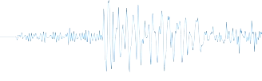
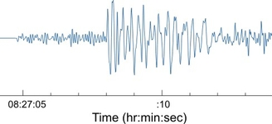








Seismic waves
$$x_{1}$$
$$x_{2}$$
$$x_{3}$$
$$x_{14}$$
$$x_{1}$$
$$x_{2}$$
$$x_{3}$$
$$x_{14}$$

Slide 23




Seismic waves: Statistical features
$$x_{1}$$
$$x_{2}$$
$$x_{3}$$
$$x_{4}$$
Statistical features do not depends on time

Slide 24
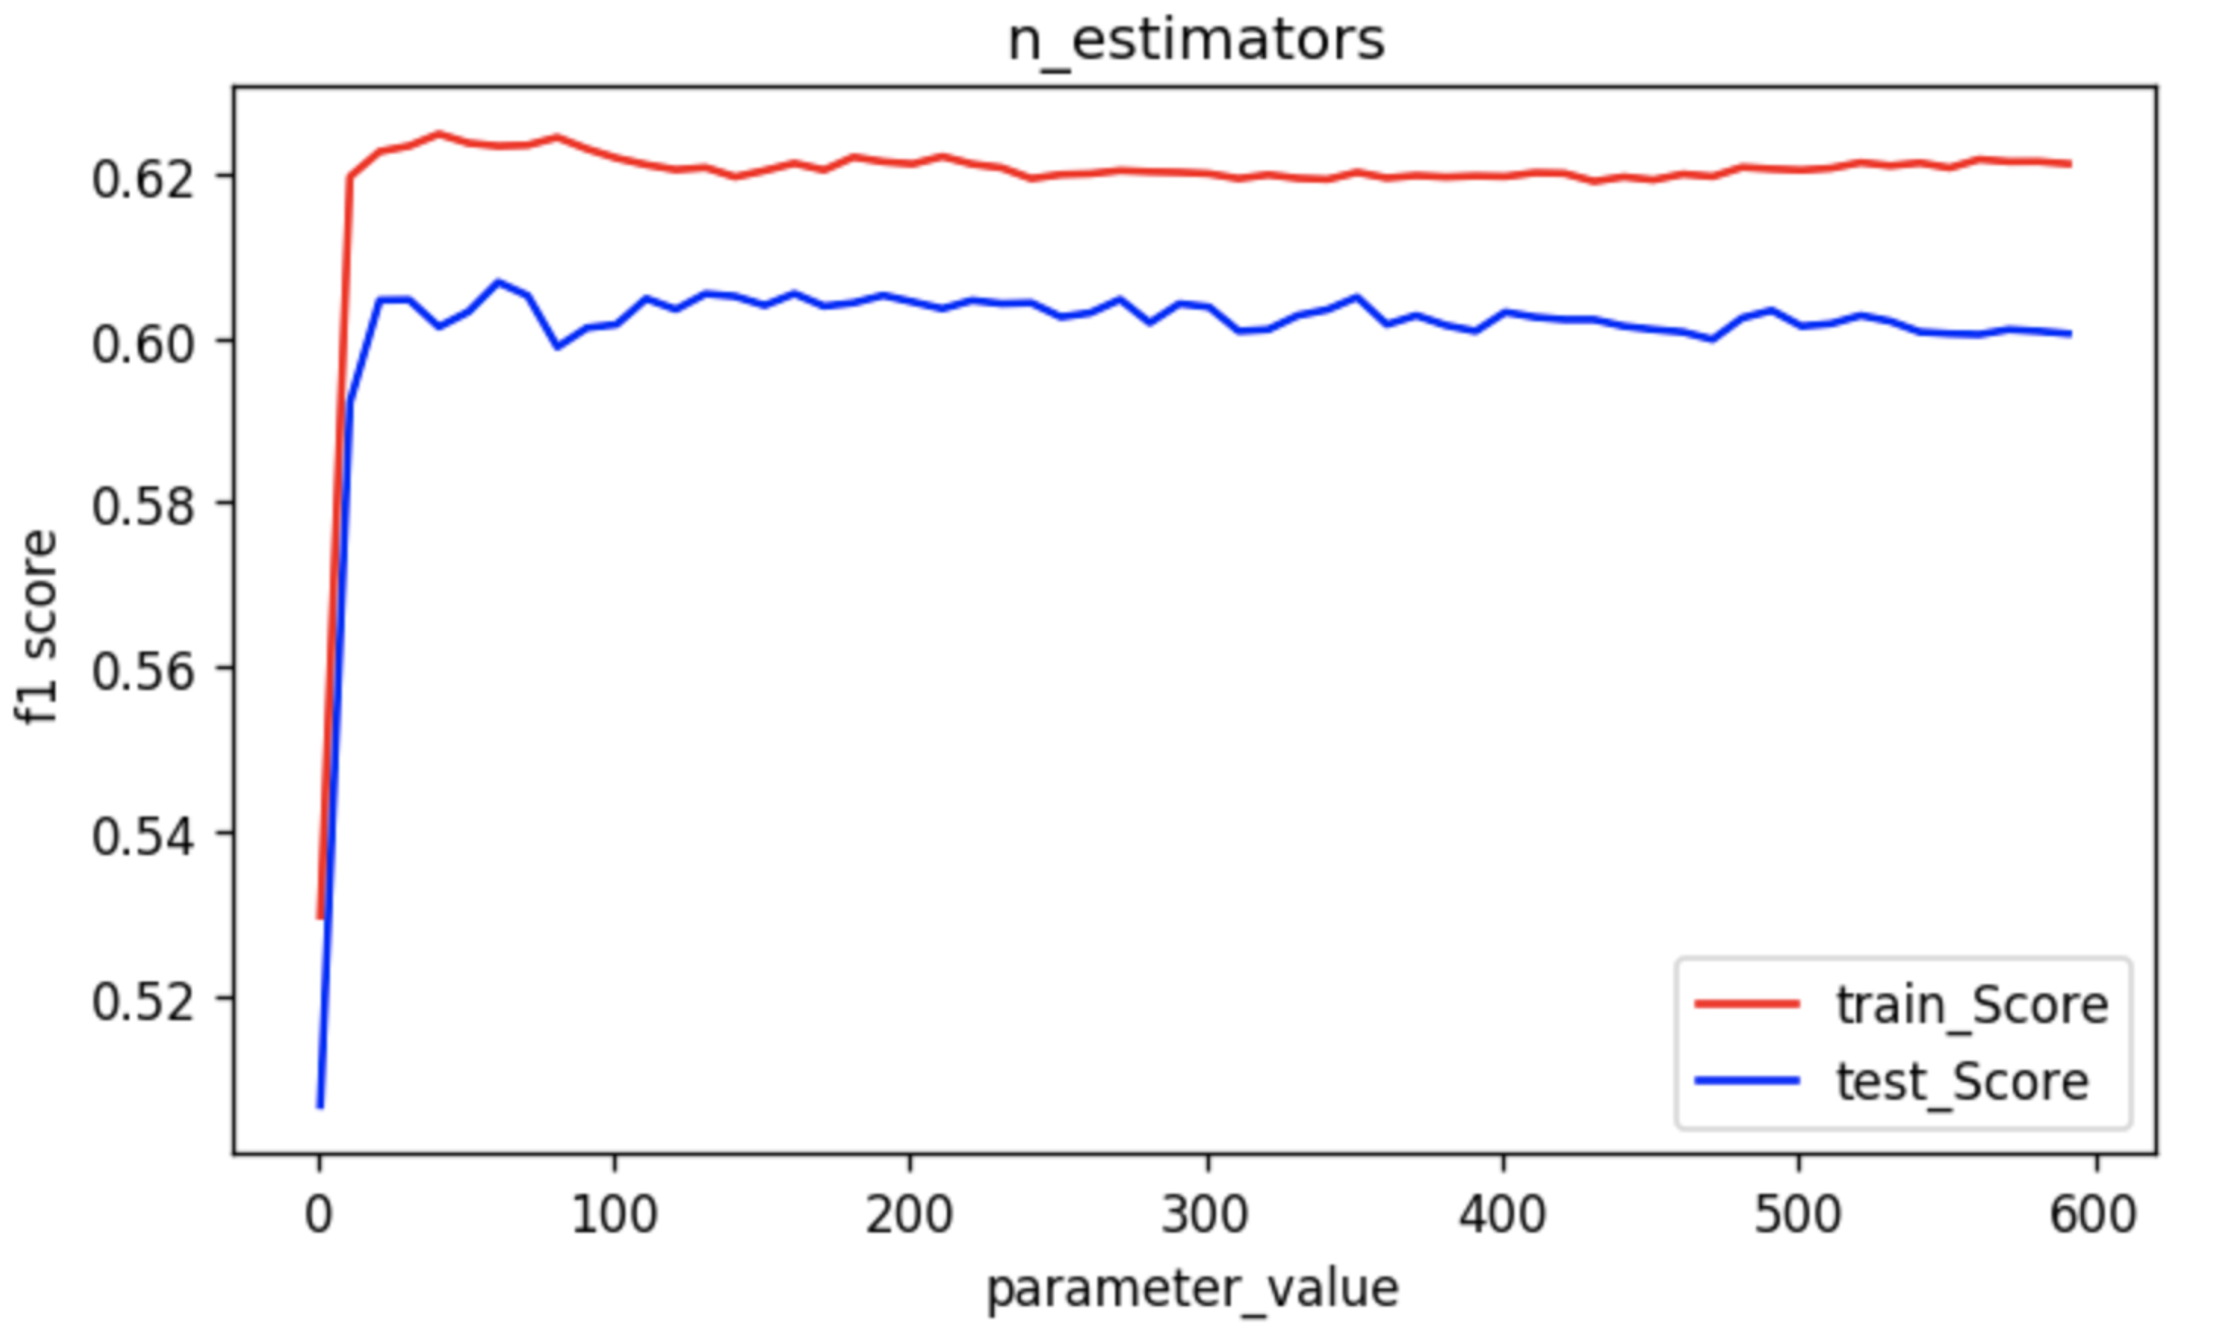


n_estimators
A Beginner’s Guide to Random Forest Hyperparameter Tuning, by SHAROON SAXENA, from Analytics Vidhya, https://www.analyticsvidhya.com/blog/2020/03/beginners-guide-random-forest-hyperparameter-tuning/
$$F1=2×\frac{Precision∗Recall}{Precision+Recall}$$

Slide 25
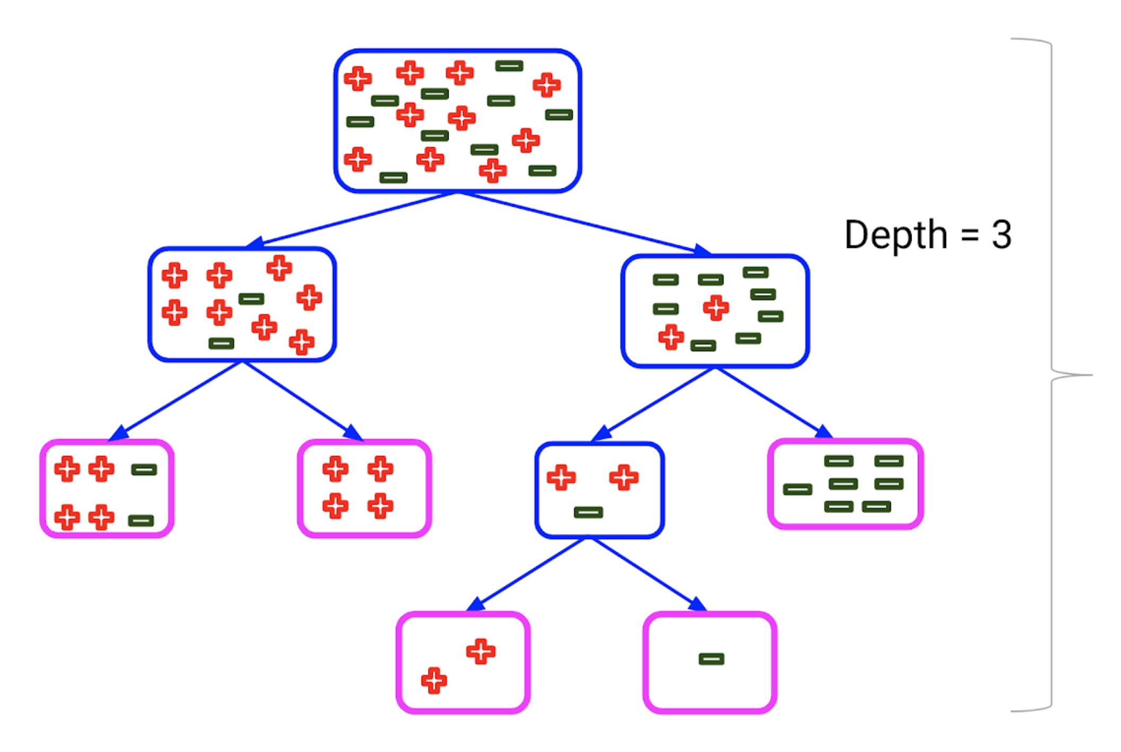
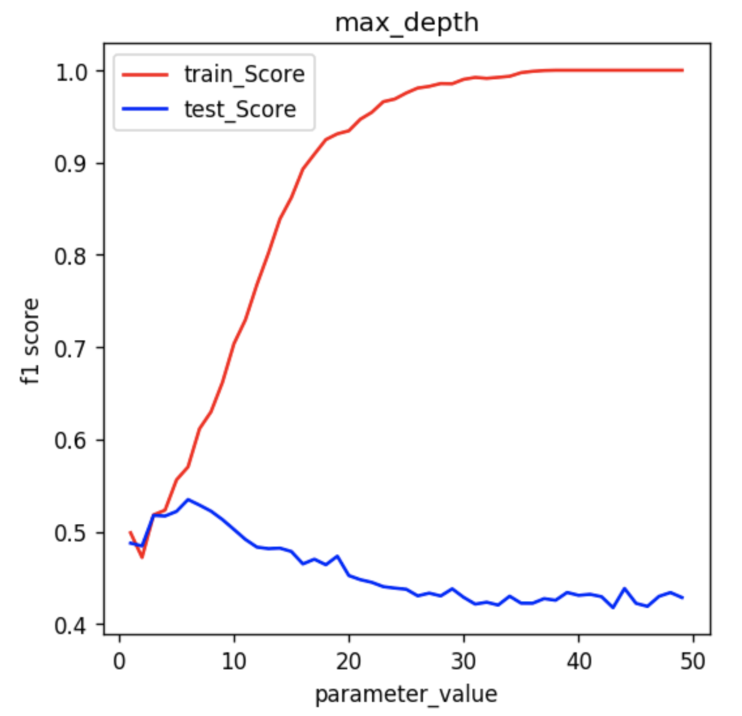
max_depth
A Beginner’s Guide to Random Forest Hyperparameter Tuning, by SHAROON SAXENA, from Analytics Vidhya, https://www.analyticsvidhya.com/blog/2020/03/beginners-guide-random-forest-hyperparameter-tuning/
$$F1=2×\frac{Precision∗Recall}{Precision+Recall}$$

Slide 26
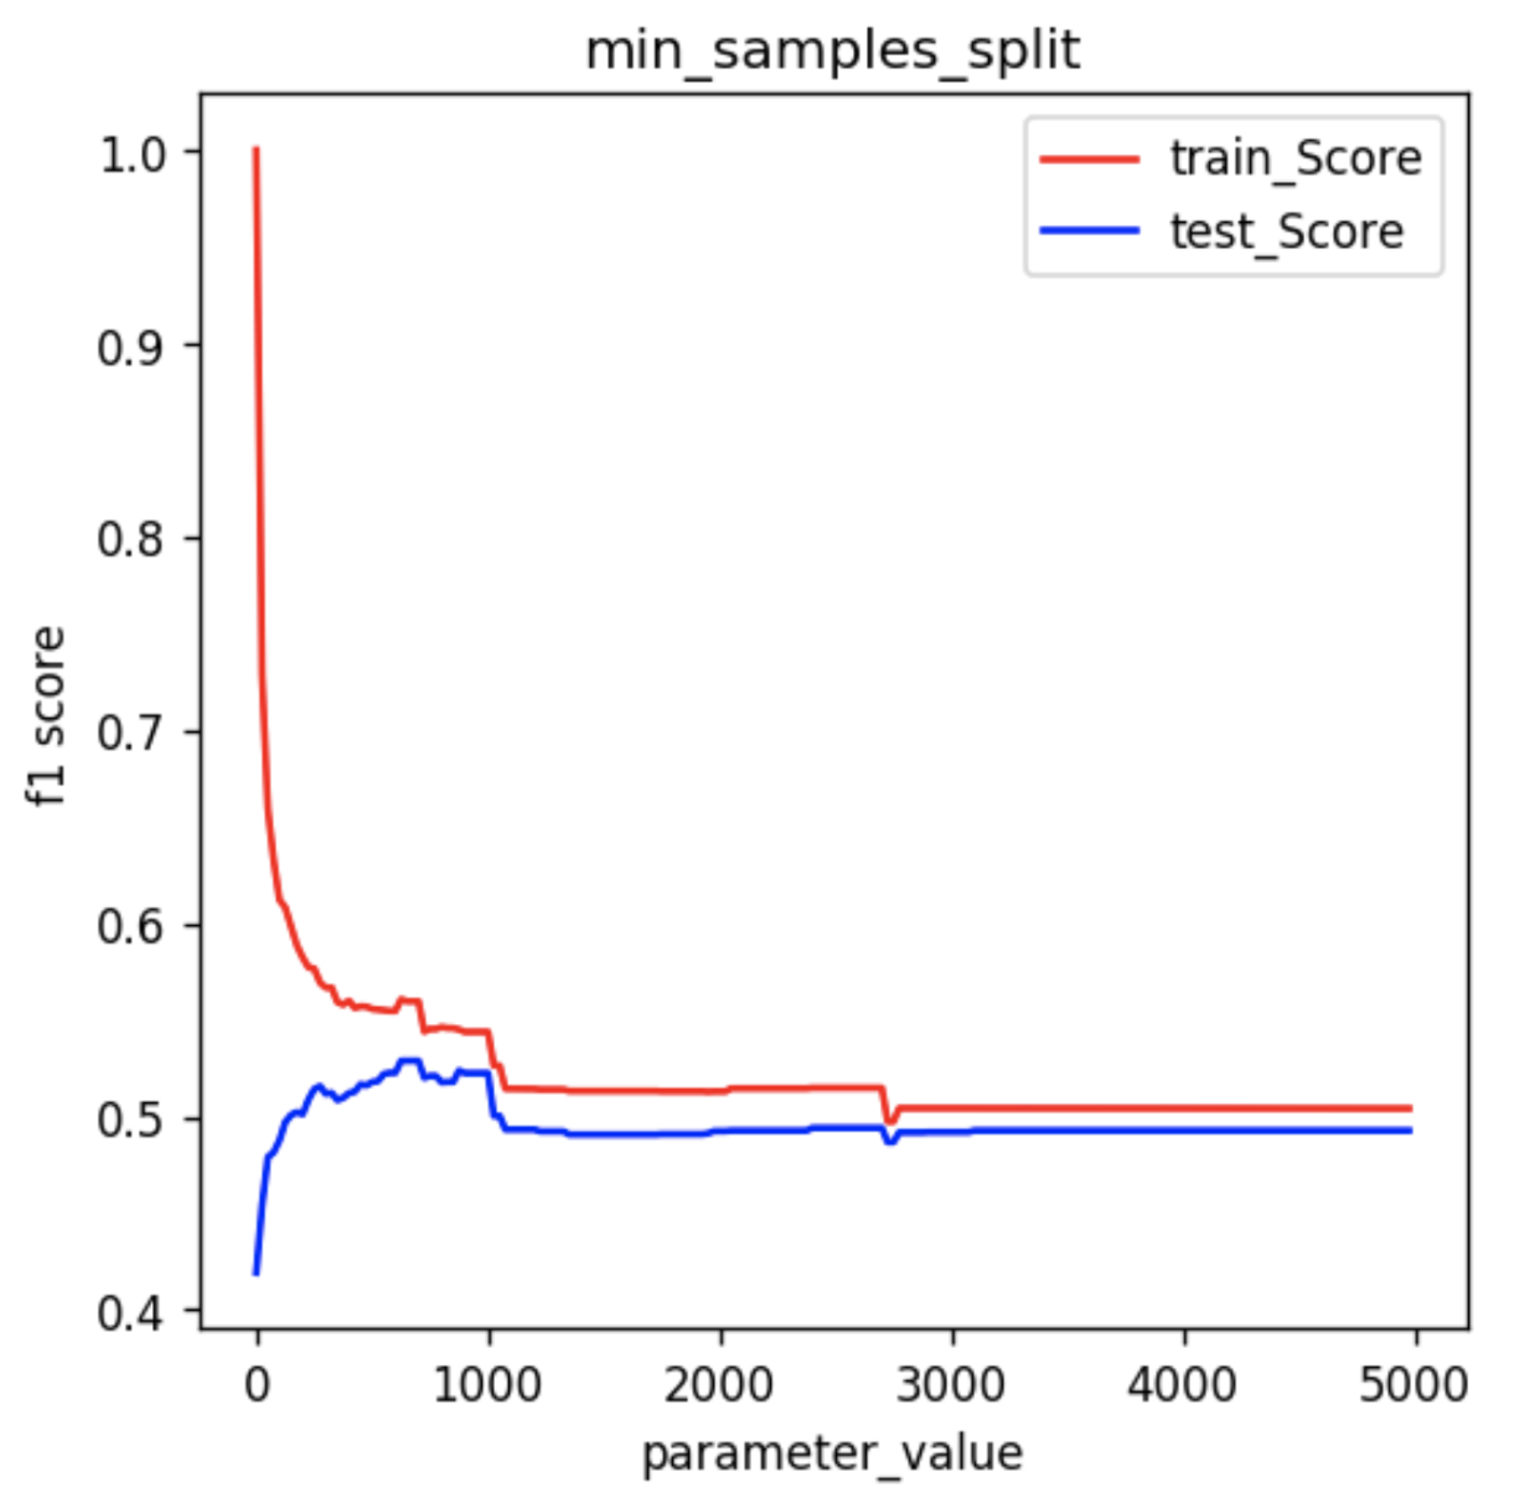
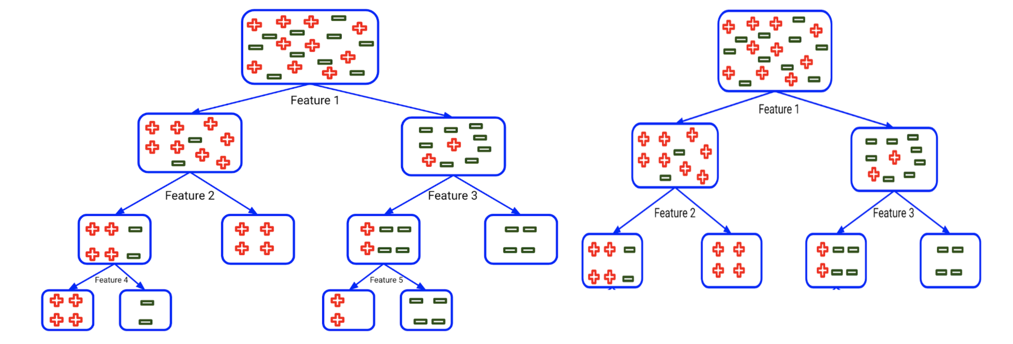
min_sample_split
A Beginner’s Guide to Random Forest Hyperparameter Tuning, by SHAROON SAXENA, from Analytics Vidhya, https://www.analyticsvidhya.com/blog/2020/03/beginners-guide-random-forest-hyperparameter-tuning/
$$F1=2×\frac{Precision∗Recall}{Precision+Recall}$$

Slide 27
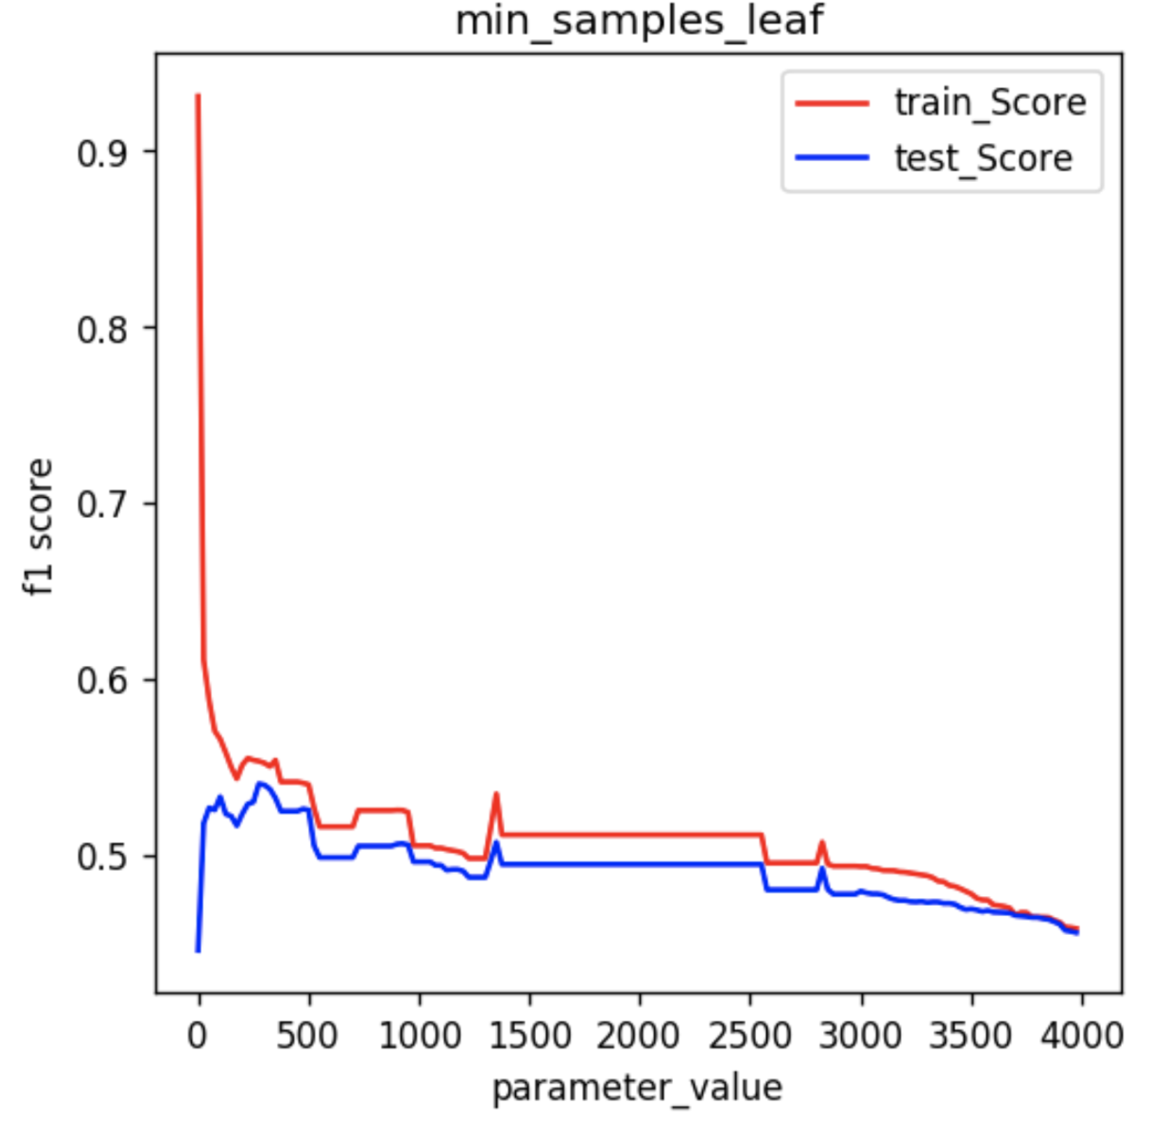
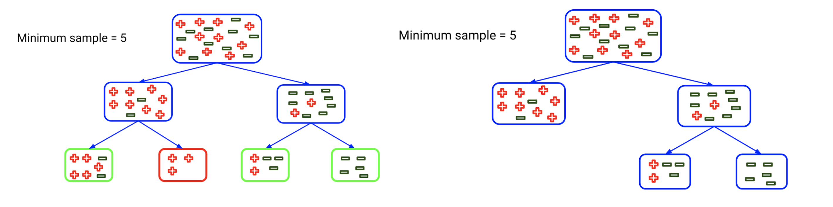
min_samples_leaf
A Beginner’s Guide to Random Forest Hyperparameter Tuning, by SHAROON SAXENA, from Analytics Vidhya, https://www.analyticsvidhya.com/blog/2020/03/beginners-guide-random-forest-hyperparameter-tuning/
$$F1=2×\frac{Precision∗Recall}{Precision+Recall}$$

Slide 28
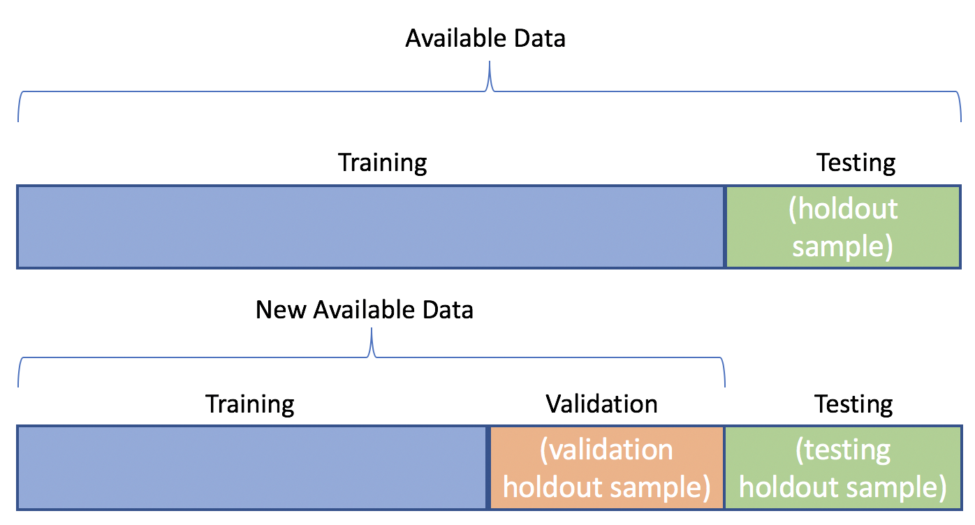
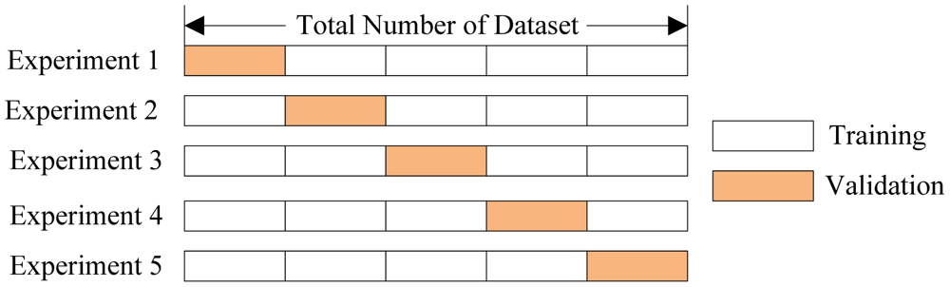
K-fold cross-validation

Slide 29
Exercise 4 (Group A)
The file exp10_1940-2021.zip contains the experimental data from Rouet-Leduc (2017)*, split up into 100 files.
The Python file ReadTDMS.py contains a class called AcousticFileReader that can read these files into a single numpy array (getData) or a Pandas DataFrame (getDataFrame).
The data contains three columns: Time, Acoustic, and Shear. The Acoustic signal is analogous to a seismic signal, the shear is analogous to the displacement of a tectonic plate during an earthquake.
*Rouet-Leduc, B., Hulbert, C., Lubbers, N., Barros, K., Humphreys, C. J., & Johnson, P. A. 2017. “Machine Learning Predicts Laboratory Earthquakes.” Geophysical Research Letters 44 (18): 9276–82. https://doi.org/10.1002/2017GL074677.

Slide 30
Exercise 4 (Group A)
Extract the data files, split them into training and validation set, and use the provided class to load the data.
Split the data into 1-second windows. The data is sampled at 330 kHz, i.e. each window contains 330 000 data points.
Calculate the mean Shear for each window and use it to identify earthquakes: The shear slowly builds up, but at some point it rapidly drops – this is an "earthquake".
For all the other windows, calculate the "time-to-failure" i.e. the number of seconds until the next earthquake. Use time-to-failure as the label.
Finally, remove all the windows that contain earthquakes (i.e. time-to-failure=0) from the dataset, since it does not make sense to predict earthquakes the moment they are happening.

Slide 31
Exercise 4 (Group A)
For each window, calculate at least four out of the following statistical quantities and save them in a csv file:
Mean
Variance
Skewedness
Kurtosis
Minimum
Maximum
1st percentile (0.01 quantile)
5th percentile (0.05 quantile)
5th percentile (0.10 quantile)
90th percentile (0.90 quantile)
95th percentile (0.95 quantile)
99th percentile (0.99 quantile) The number of data points > 1e-9
The number of data points > 1e-8
The number of data points > 1e-7
The number of data points < -1e-7
The number of data points < -1e-8
The number of data points < -1e-9
Bonus: It is possible to do all these tasks with Pandas without using any loops. The functions groupby, cumsum, cumcount, and aggregate may be helpful.

Slide 32
Exercise 4 (Group A)
Train a random forest to predict time-to-failure using the statistical features.
Plot predicted and actual times-to-failure over time (like Rouet-Leduc et al., 2017)
Validate it: plot the predicted vs actual times-to-failure. Does there seem to be a strong correlation?
Print or plot at least one tree (estimator), and explain (roughly) what this tree does.
Bonus: Test which hyper-parameters (n_estimators, max_split, min_sample_split, min_samples_leaf) yield the best parameters.

Slide 33
Exercise 4 (Group B)
The file exp10_1940-2021.zip contains the experimental data from Rouet-Leduc (2017)*, split up into 100 files.
The Python file ReadTDMS.py contains a class called AcousticFileReader that can read these files into a single numpy array (getData) or a Pandas DataFrame (getDataFrame).
The data contains three columns: Time, Acoustic, and Shear. The Acoustic signal is analogous to a seismic signal, the shear is analogous to the displacement of a tectonic plate during an earthquake.
*Rouet-Leduc, B., Hulbert, C., Lubbers, N., Barros, K., Humphreys, C. J., & Johnson, P. A. 2017. “Machine Learning Predicts Laboratory Earthquakes.” Geophysical Research Letters 44 (18): 9276–82. https://doi.org/10.1002/2017GL074677.

Slide 34
Exercise 4 (Group B)
Extract the data files, split them into training and validation set, and use the provided class to load the data.
Split the data into 1-second windows. The data is sampled at 330 kHz, i.e. each window contains 330 000 data points.
Calculate the mean Shear for each window and use it to identify earthquakes: The shear slowly builds up, but at some point it rapidly drops – this is an "earthquake".
For all the other windows, calculate the "time-to-failure" i.e. the number of seconds until the next earthquake. Use time-to-failure as the label.
Finally, remove all the windows that contain earthquakes (i.e. time-to-failure=0) from the dataset, since it does not make sense to predict earthquakes the moment they are happening.

Slide 35
Exercise 4 (Group B)
For each window, calculate at least four out of the following statistical quantities and save them in a csv file:
Mean
Variance
Skewedness
Kurtosis
Minimum
Maximum
1st percentile (0.01 quantile)
5th percentile (0.05 quantile)
5th percentile (0.10 quantile)
90th percentile (0.90 quantile)
95th percentile (0.95 quantile)
99th percentile (0.99 quantile) The number of data points > 1e-9
The number of data points > 1e-8
The number of data points > 1e-7
The number of data points < -1e-7
The number of data points < -1e-8
The number of data points < -1e-9
Bonus: It is possible to do all these tasks with Pandas without using any loops. The functions groupby, cumsum, cumcount, and aggregate may be helpful.

Slide 36
Exercise 4 (Group B)
Train a random forest to predict time-to-failure using the statistical features.
Plot predicted and actual times-to-failure over time (like Rouet-Leduc et al., 2017)
Identify the most important feature and plot it together with time-to-failure vs. time.
Bonus: Test which hyper-parameters (n_estimators, max_split, min_sample_split, min_samples_leaf) yield the best parameters.

Slide 37
Random Forest – Recommended Reading
Random Forest in Python, by Will Koehrsen from Towards Data Science: https://towardsdatascience.com/random-forest-in-python-24d0893d51c0
Understanding Random Forests Classifiers in Python, by Avinash Navlani from DataCamp: https://www.datacamp.com/community/tutorials/random-forests-classifier-python
Random Forest Algorithm with Python and Scikit-Learn, by Usman Malik from Stack Abuse: https://stackabuse.com/random-forest-algorithm-with-python-and-scikit-learn/

Slide 38
Random Forest – Optional Resources
Machine Learning class by Kilian Weinberger from Cornell University, Lecture Notes, Lectures 17 and 18 on Decision Trees and Bagging http://www.cs.cornell.edu/courses/cs4780/2018fa/lectures/
Machine Learning class by Kilian Weinberger from Cornell University, Lecture Videos 29-31 on Decision Trees and Bagging https://www.youtube.com/playlist?list=PLl8OlHZGYOQ7bkVbuRthEsaLr7bONzbXS (uploaded on Blackboard)

